Slide 1
Cyclistic Data Analysis Project
From: Google Data Analytics Certificate

Slide 2
Task
How do annual members and casual riders use Cyclistic bikes differently?
Provide recommendations based on your findings.

Slide 3
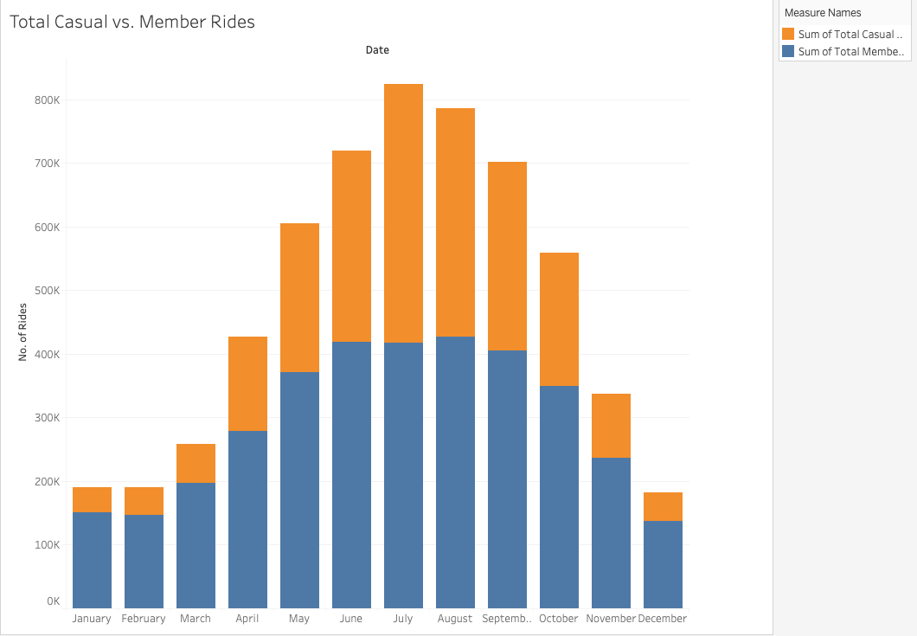
Bike usage is at a high during the summer months, with 823,488 users at its peak.
Casual and Member users are at an equal during the month of July, in which Casual riders were 406,055 and Member riders 417,433.
During the Winter months, Member users out number Casual users 3:1.
The month of December having the lowest users with a combined users of 181,806.

Slide 4
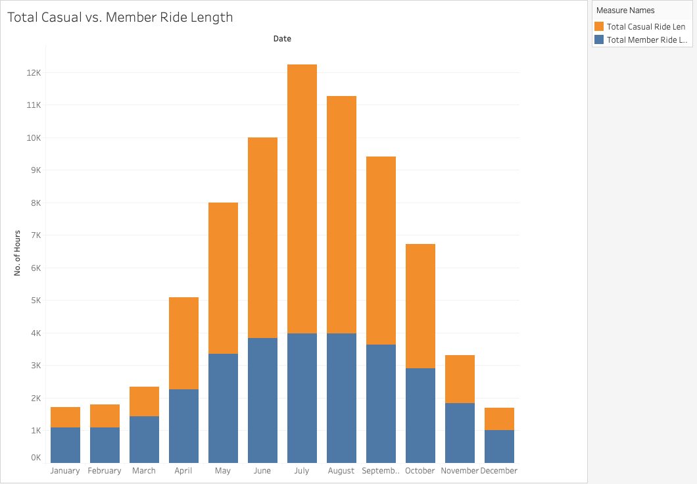
We see longer usage during the summer months with 12,233 mins of combined usage at its peak in July.
We see that casual riders out use member riders 2:1 during summer months.
We also see that winter months have the lowest usage time with December being the lowest with a combined usage of 1,705.
We also found out that Member riders out use Casual riders 1.5:1 during the winter months.

Slide 5
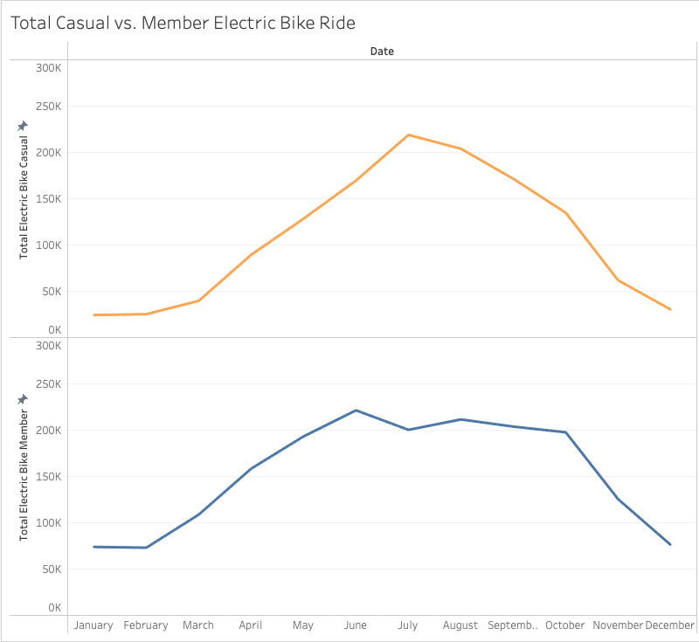
We see that Electric Bikes have peak usage during summer months with 218,905 Casual users and 200,000 Member users.
We see a sharp increase of usage during spring on both Casual and Member users.
We also see a sharp decline after the summer in Casual users but, Member users tend to plateau during the fall months and then during the winter months decline in usage.
We also see that compared to other bikes in the roster Electric bikes have the most usage.

Slide 6
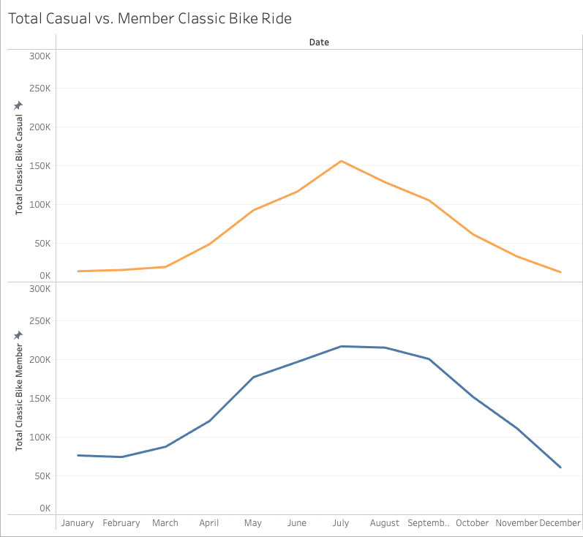
Classic bikes are the second most used bikes in the roster.
This bike has the most use during peak months with 156,095 of Casual users and 217,078 Member users.
We see a sharp increase before the summer months and sharp decrease during the fall months of casual users.
But with Member users we see a gradual increase and a plateauing and then decrease of usage during the winter months.

Slide 7
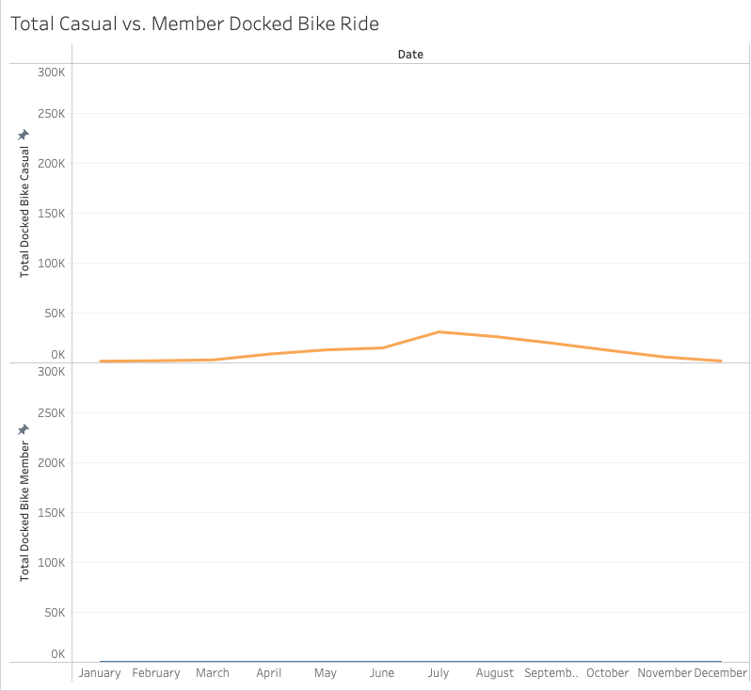
The Docked bikes are the least utilized in the roster with a max use of a little over 30,000 in a year.
We see only Casual users and that too during the summer months.
We also found 0 Member users of the docked bikes.

Slide 8
Summary
Summer months are the most primal time for bike usage and winter months are a slow season for bike usage.
We see Member users out number Casual users except during the summer months where their seams to be an equilibrium.
Casual riders use the bikes longer than Member users except during the winter months where Member riders use the bikes for longer.
Electric bikes are the most utilized and docked bikes are the least utilized in the inventory.

Slide 9
Recommendations
Docked bikes are the least used bike in the inventory so we recommend dropping it and doubling the Electric bikes which have more use in the inventory.
Summer months are the most busiest time of the years so all bikes must finish all repairs by then.
We see casual riders riding for longer during the summer months, so we recommend higher fees for casual users due to repair cost to maintain them.
We also recommend to keep spare parts of the Electric bikes in stock due to high usage before the summer months for quick and efficient repairs.

Slide 10
Thank you for your time

